Slide 1
MACHINE LEARNING
COURSE INSTRUCTORS:
EVANS TETTEH OWUSU
HEANAMPONG CLEMENT

Slide 2
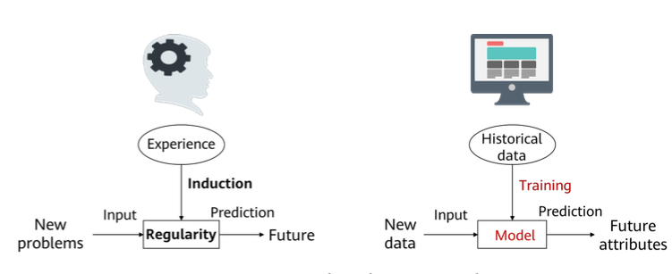
OVERVIEW

Slide 3
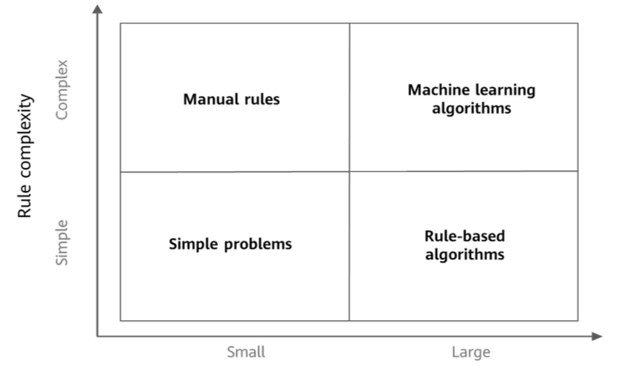
It is very difficult to identify spam emails by using conventional programming methods.
In theory, we should be able to find a set of rules that are met by any spam emails but
not by normal emails. This approach to problem solving using explicit programming is
called a rule-based approach. In practice, it is almost impossible to find such a set of
rules. Therefore, a statistics-based approach is used by machine learning to solve
problems.

Slide 4
Generally, machine learning is applicable to:
Scenarios with complex rules or rules difficult to describe, for example, facial
recognition and speech recognition.
Scenarios with data distribution changing over time and constant readaptation of
programs required, for example, sales trend forecast

Slide 5
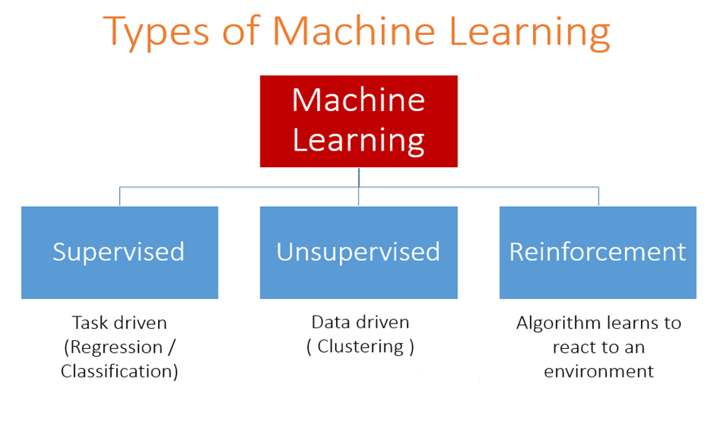
MACHINE LEARNING TYPES
Supervised
Unsupervised
Semi-supervised
Self-supervised
Online learning
Batch learning
Genralization Approaches
Instantce based learning
Model based learning

Slide 6
MAIN CHALLENGES OF MACHINE LEARNING
Bad data
Insufficient quality of the data
Nonrepresentative training data
Poor quality data
Irrelevant features
Bad model
Overfitting the training data
Underfitting the training data

Slide 7
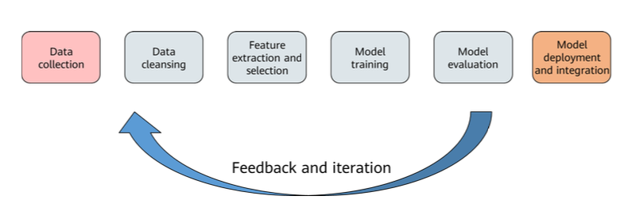
MACHINE LEARNING PROCESSES

Slide 8
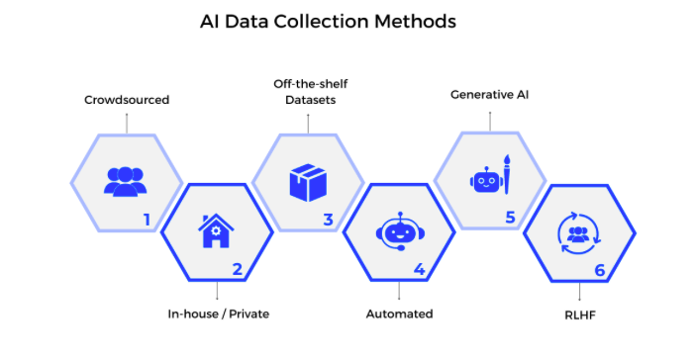
Data collection
Data collection in machine learning refers to the initial step of gathering relevant information from various sources to build a dataset that can be used to train and test a machine learning model.

Slide 9
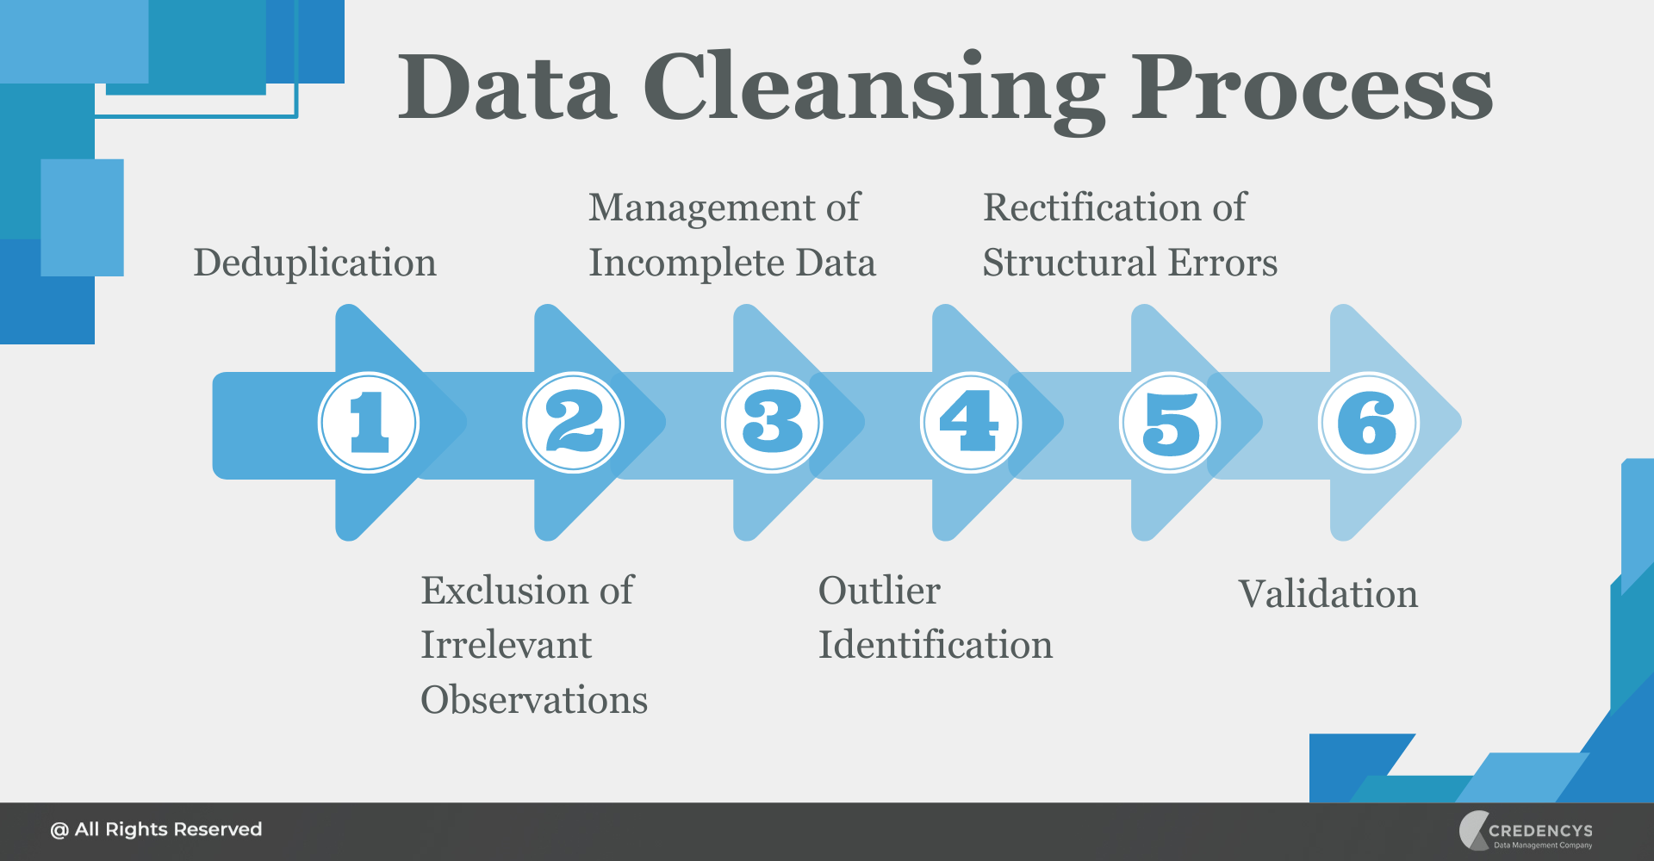
DATA CLEANSING

Slide 10
FEATURE EXTRACTION AND FEATURE SELECTION
Feature Selection Methods
Wrapper method
Embedded method
Filter method
Feature Extraction Methods
PCA
LDA
Kernel PCA
Autoencoders

Slide 11
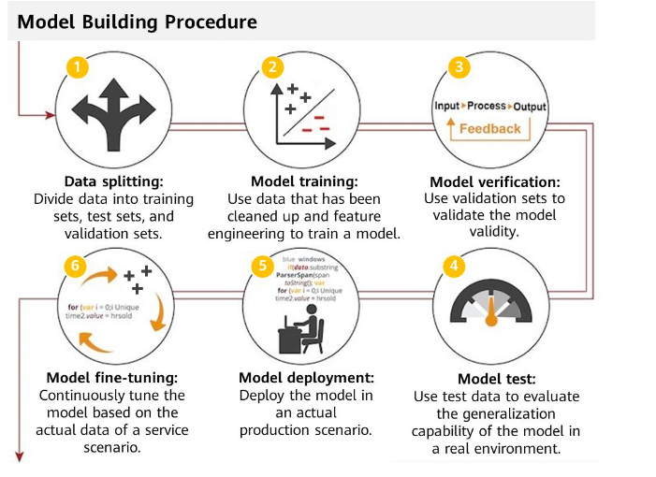
BUILDING A MODEL

Slide 12
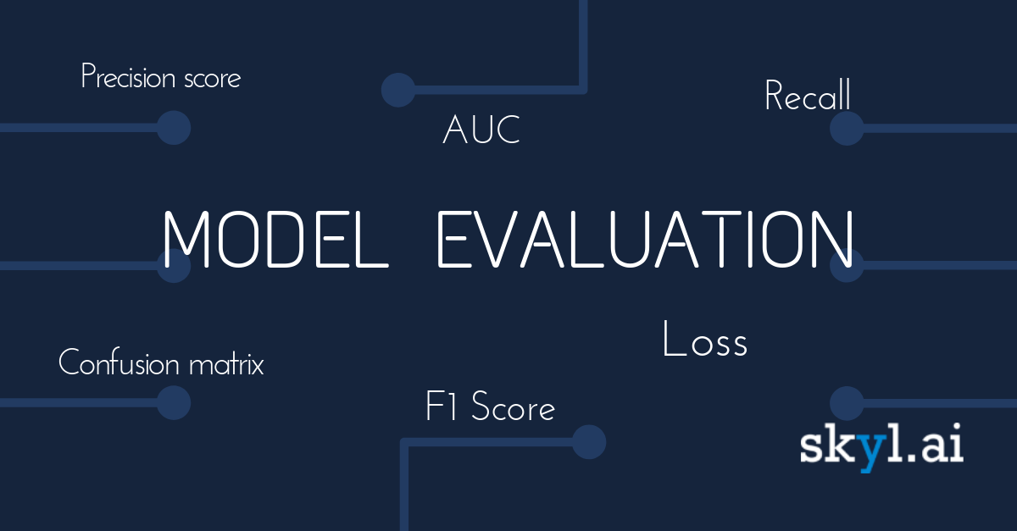
Model evaluation

Slide 13
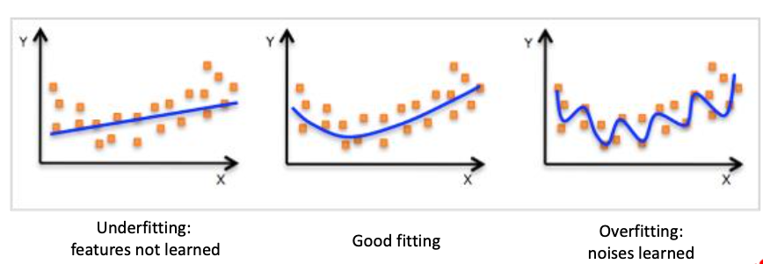

Slide 14
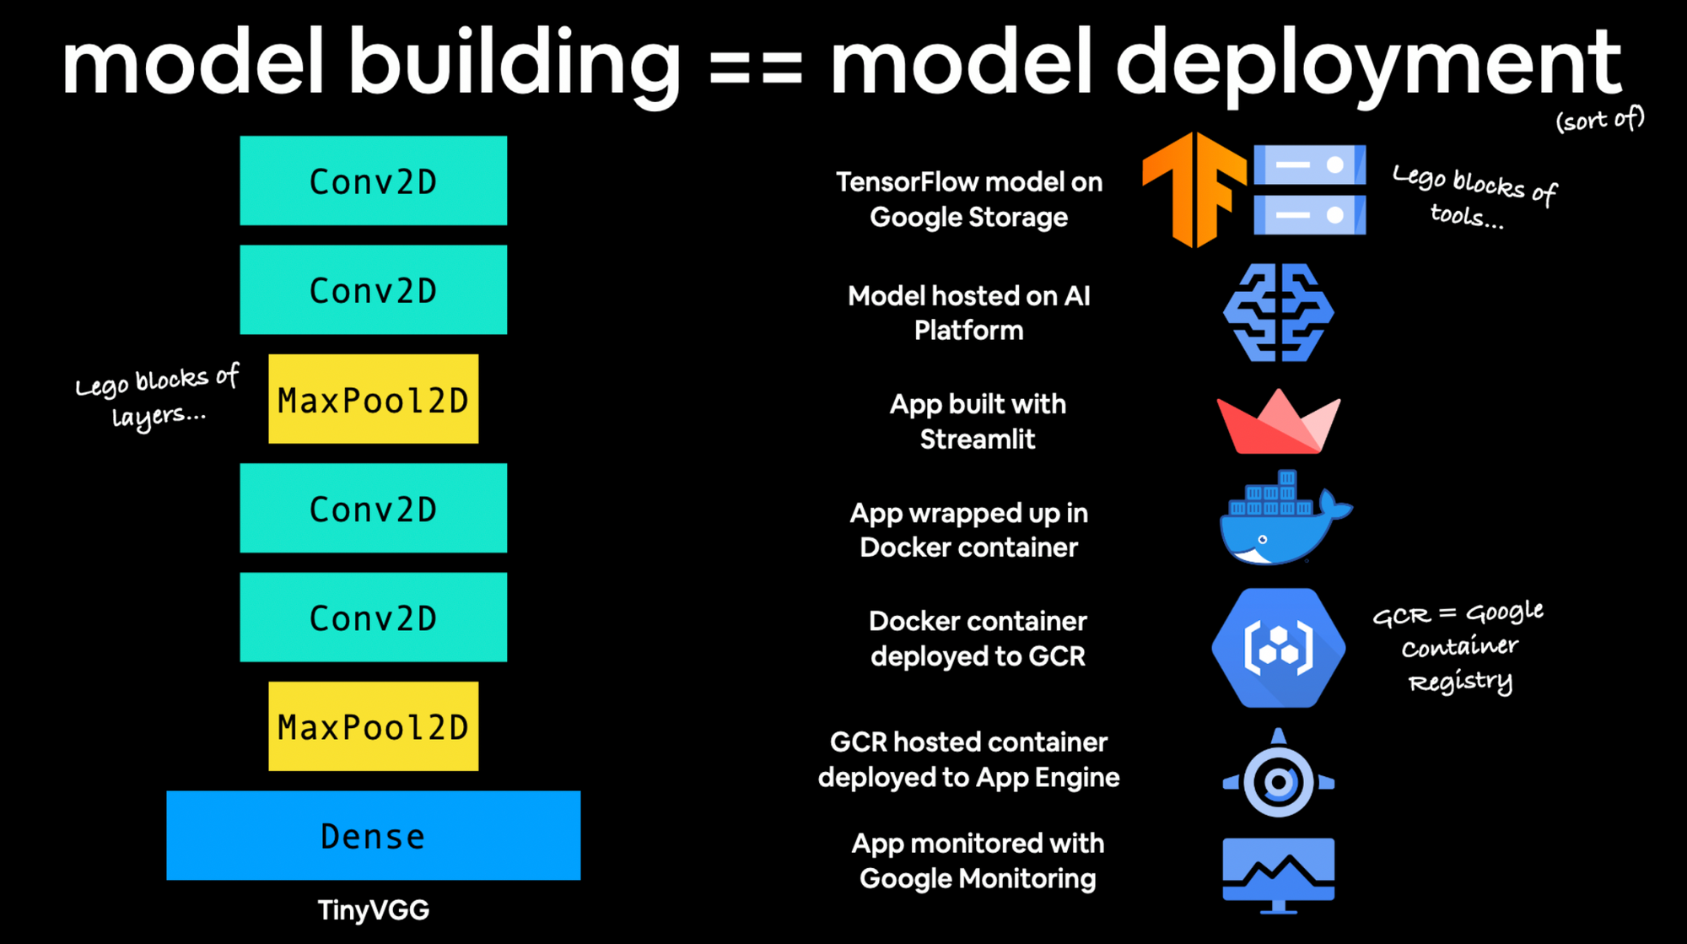
MODEL DEPLOYMENT

